Slide 1


Student Details
Name : Somineni Veerendra
Skills build email id : veerendrasomineni@gmail.com
College name : R.V.R & JC College of Engineering, Guntur
College state : Andhra Pradesh
Internship domain : Artificial Intelligence and Machine Learning
Internship start date : 03/06/2024
Internship end date : 15/07/2024

Slide 2
PROJECT TITLE/Problem Statement
Employee burnout is a state of physical, emotional and mental exhaustion caused by excessive and prolonged stress. It can have serious consequences on an individual’s well-being and can lead to decreased productivity and job performance. In today’s fast-paced and constantly connected world, it is increasingly important to recognize and address the signs of burnout in order to maintain the health and well-being of employees.
We will be exploring the use of regression techniques to predict employee burnout. By analyzing a dataset containing various factors that may contribute to burnout such as workload, mental fatigue job and work-life balance, we can develop a model to identify individuals who may be at risk of burnout. By proactively addressing these risk factors, organizations can help prevent burnout and promote the well-being of their employees

Slide 3
AGENDA
Problem Statement
Project Overview
Who are the end users of the project?
Your solution and its value proposition
How did you customize the project and make it your own
Modelling
Result
Links

Slide 4
PROJECT OVERVIEW
Introduction: Employee burnout denotes a critical state of physical, emotional, and mental exhaustion triggered by excessive and prolonged stress. It gravely compromises an individual's well-being, resulting in reduced productivity and job performance. In today’s fast-paced, ever-connected environment, recognizing and combating the signs of burnout is essential to maintain employee health and efficiency.
This project utilizes regression techniques to predict employee burnout. By analyzing a dataset featuring factors such as workload, mental fatigue, job demands, and work-life balance, we aim to develop a predictive model that identifies individuals at risk of burnout. Through proactive intervention, organizations can prevent burnout and foster a healthier, more productive workforce. combine formation and rewrite for ppt presentation as a project overview
Key Symptoms of Burnout:
Emotional Exhaustion:
Feeling drained and depleted of emotional resources.
Overwhelming fatigue that doesn't improve with rest.

Slide 5
Depersonalization:
Developing a cynical attitude towards one’s job and colleagues.
Experiencing detachment and a sense of disconnection from work and coworkers.
Reduced Personal Accomplishment:
Feeling ineffective and lacking a sense of achievement.
Decreased productivity and lower work performance.
Physical Symptoms:
Chronic fatigue, headaches, sleep disturbances, and gastrointestinal problems.
Emotional Symptoms:
Feeling overwhelmed, irritable, anxious, and depressed.
Significance: Burnout gravely compromises an individual's well-being, leading to reduced productivity and job performance. In today’s fast-paced, ever-connected environment, recognizing and combating burnout signs is crucial for maintaining employee health and efficiency.
Project Objective: This project aims to predict employee burnout using regression techniques. By analyzing a dataset featuring factors such as workload, mental fatigue, job demands, and work-life balance, we seek to develop a predictive model to identify individuals at risk of burnout.

Slide 6
WHO ARE THE END USERS of this project?
The end users of an employee burnout prediction project typically include various stakeholders within an organization who are responsible for employee well-being, productivity, and overall organizational health. Here are some of the key end users:
Human Resources (HR) Department:
HR Managers and Specialists: Use the prediction model to identify at-risk employees and develop intervention strategies.
Line Managers and Supervisors:
Team Leaders: Monitor their team members' well-being and address burnout proactively.
Department Heads: Implement department-wide changes to reduce burnout risks.
Employee Assistance Programs (EAP):
EAP Coordinators: Tailor support services and counseling based on the burnout risk data.
Data Analysts and IT Departments:
Data Scientists and Analysts: Develop, refine, and maintain the burnout prediction model.
IT Support: Ensure the technical infrastructure supports the data collection and analysis process.

Slide 7
Employees:
Self-awareness: Employees may have access to personal burnout risk assessments and resources to manage stress and seek support.
Organizational Development (OD) Professionals:
OD Consultants: Use insights from the model to recommend organizational changes and improve workplace culture.

Slide 8
YOUR SOLUTION AND ITS VALUE PROPOSITION
Our solution combines data analysis, predictive modeling, and targeted interventions to address employee burnout and promote a healthier work environment. By identifying burnout causes and risk factors, we can implement proactive strategies that enhance employee well-being and engagement.
Data Collection
Data Analysis
Reporting and Recommendations
Implementation Support:
Enhanced Employee Well-being
Increased Organizational Productivity:
Lower Turnover Rates
Cost Savings
Positive Organizational Culture:
Data-Driven Decision Making

Slide 9
VALUE PROPOSITION:
The value proposition of our solution lies in reducing burnout-related costs, improving employee satisfaction and retention, and driving overall organizational success.
PROACTIVE RISK MANAGEMENT
IMPROVED PRODUCTIVITY
ENHANCED EMPLOYEE WELL-BEGIN
RETENTION AND RECRUITMENT
DATA-DRIVEN DECISIONS
COMPLIANCE AND ETHICS

Slide 10
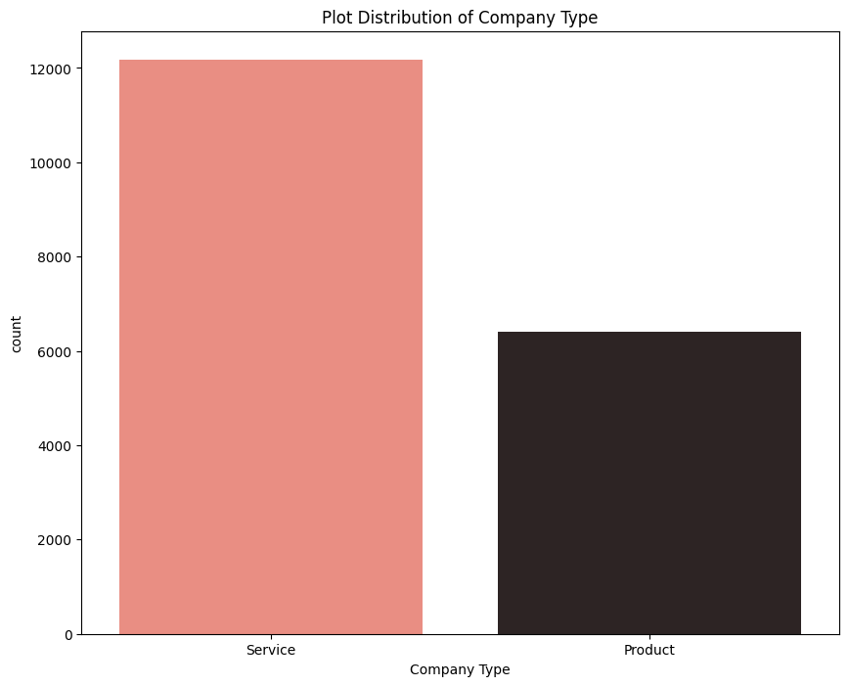
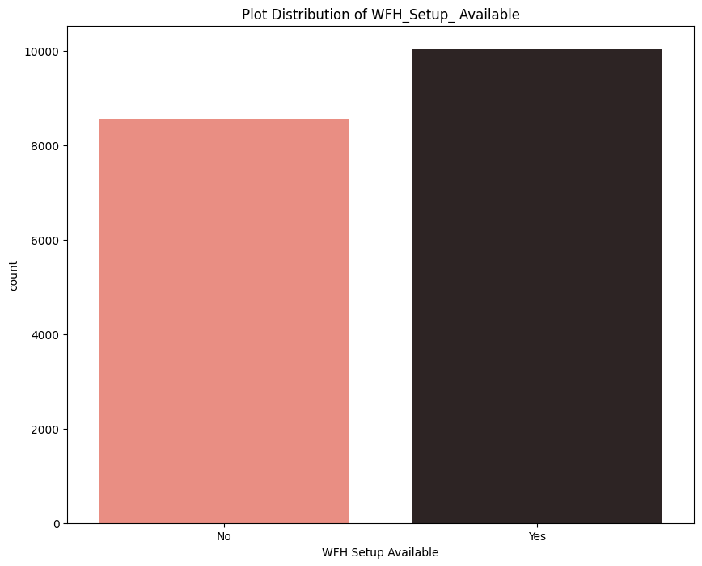
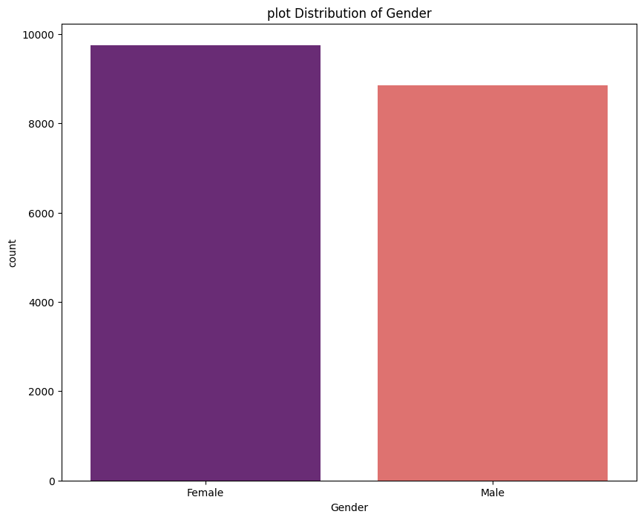
How did you customize the project and make it your own
How I Customized and Made the Project My Own:
Data Visualization:
Plot Distribution on Burn Rate: Analyzed and visualized the distribution of the burn rate related to every column in the Excel file. This involved creating histograms, bar charts, and scatter plots to understand the relationship between different variables and the burn rate. These visualizations provided insights into which factors were most strongly correlated with burnout.

Slide 11
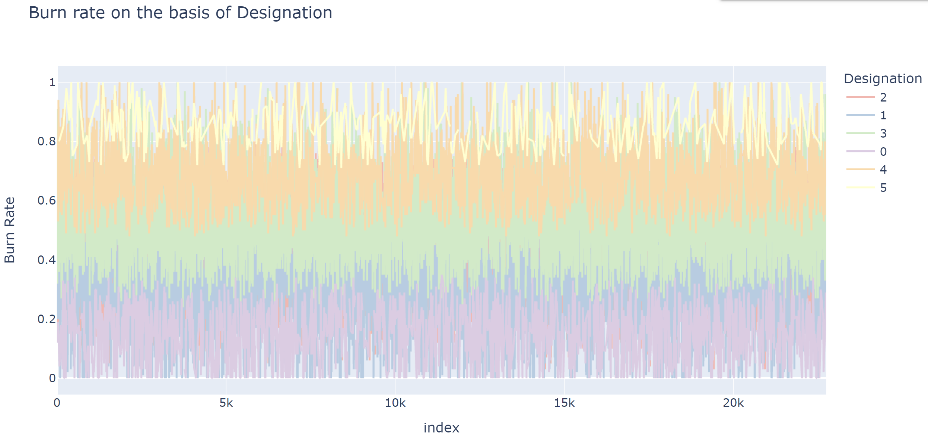
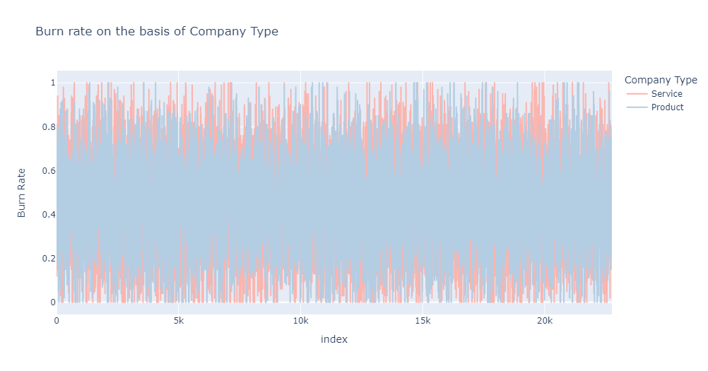

Slide 12
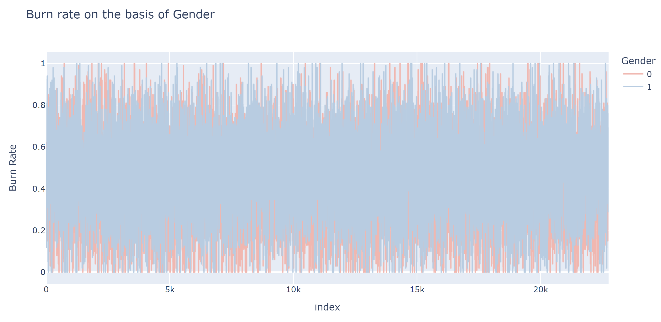
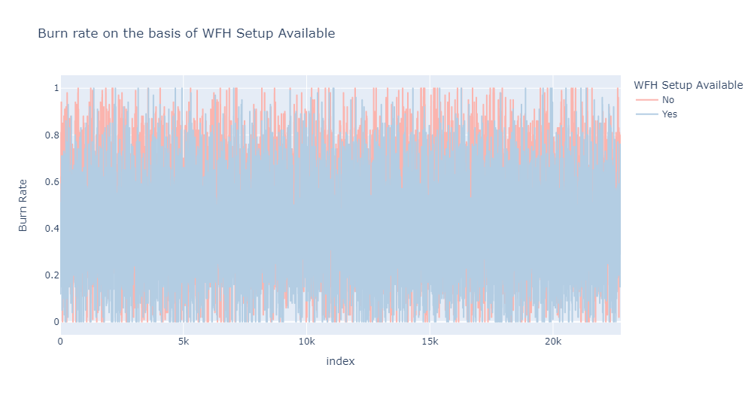

Slide 13
Model Implementation:
Support Vector Machine (SVM) Regression:
Implemented SVM regression models with both linear and RBF kernels.
The linear kernel provided a straightforward model for understanding the relationship between features and burnout.
The RBF kernel allowed for capturing more complex, non-linear relationships in the data, enhancing prediction accuracy.
Decision Tree with AdaBoost Regressor:
Used the AdaBoost algorithm to boost the performance of a decision tree regressor.
The AdaBoost regressor helped in improving the robustness and accuracy of the model by combining multiple weak learners to form a strong predictor.

Slide 14
MODELLING
The step by step process of model building:
Download Data Sheet:
Obtain the Employee Burnout Analysis dataset, which includes various factors contributing to burnout such as workload, mental fatigue, job demands, and work-life balance.
Upload Data Sheet:
Use Google Colab, a cloud-based platform, for data analysis and model development. This allows for easy collaboration and access to powerful computing resources.
Run Code:
Utilize pandas, a powerful data manipulation library in Python, to load, clean, and explore the dataset. This includes handling missing values, encoding categorical variables, and scaling numerical features.
Feature Selection:
Identify key features that have a significant impact on predicting burnout. This step involves statistical analysis and domain knowledge to select the most relevant variables.
Model Training:
Train multiple models, including Linear Regression, Decision Tree, and Support Vector Machine (SVM) with both linear and radial basis function (RBF) kernels. Each model is trained on the selected features to predict burnout risk.
Evaluate Models:
Compare the performance of the trained models using metrics such as Mean Squared Error (MSE), Root Mean Squared Error (RMSE), Mean Absolute Error (MAE), and R-squared scores. These metrics help determine the accuracy and reliability of each model.
Deploy Best Model:
Select the model with the best performance metrics for deployment. This model will be used to identify employees at risk of burnout, allowing for proactive intervention and support.

Slide 15
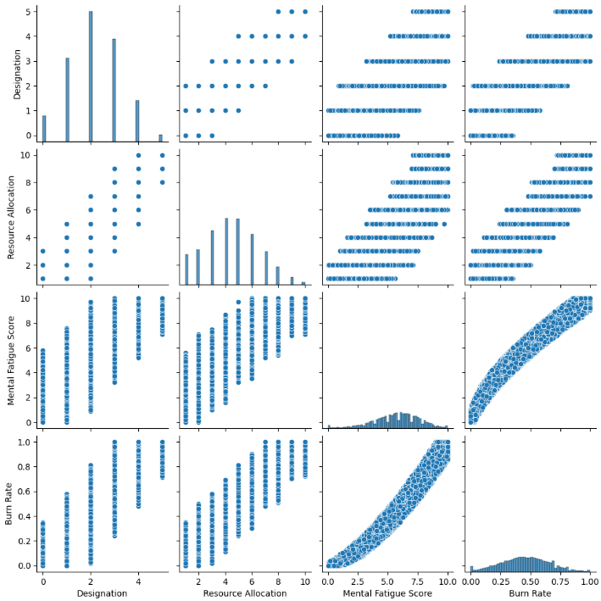
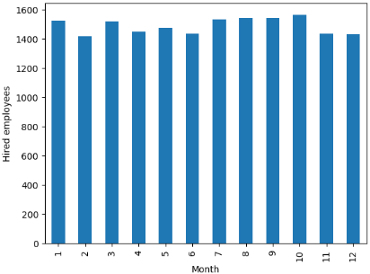
Results
Two variables are strongly correlated with target variable, therefore , important to estimate it.
Checking the correlation of Date of Joining with Target variable

Slide 16
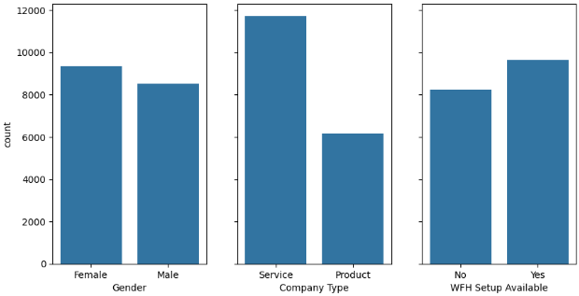
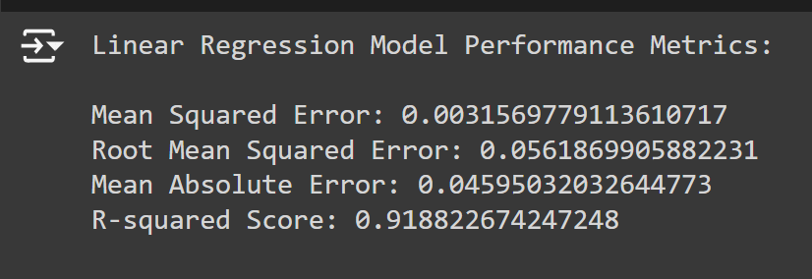
The number of observations of each category on each variable is equally distributed, except to the Company_Type where the number of service jobs its almost twice that of product ones.
Final result, tells that it has the lowest mean squared error, root mean squared error, and mean absolute error, indicating better accuracy and precision in its predictions. Additionally, it has the highest R-squared score, indicating a good fit to the data and explaining a higher proportion of the variance in the target variable. So we are choosing this model for deployment.

Slide 17
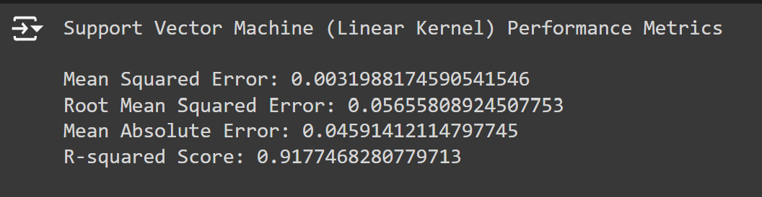
Model Performance:
Linear Regression: Selected for deployment due to lowest MSE, RMSE, MAE, and highest R-squared.
Insights:
Key factors contributing to burnout identified.
Proposed interventions based on data-driven insights.
Impact:
Improved understanding of burnout causes.
Recommendations for reducing burnout and enhancing employee engagement.
Linear Regression
Support Vector Machine(Linear Kernel)

Slide 18
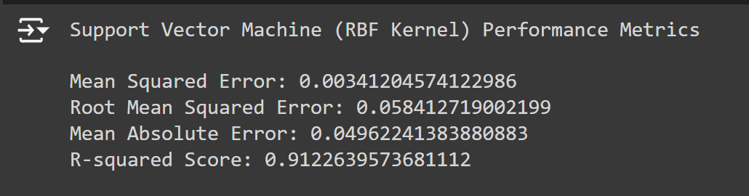
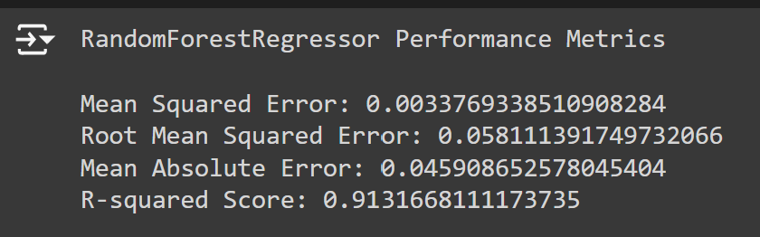
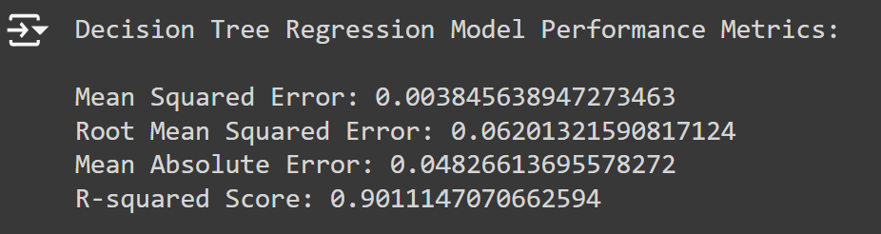
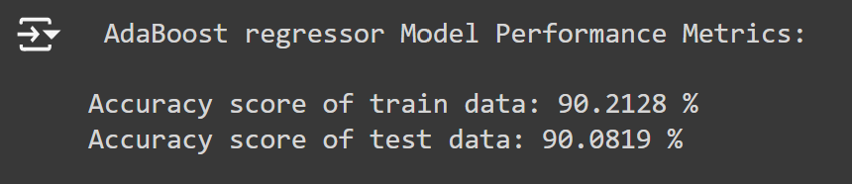
Support Vector Machine (RBF Kernel)
Random Forest Reggressor
Decision Tree Regressor
AdaBoost Regressor

Slide 19
links
https://github.com/SRKVeerendra/Employee_Burnout_Analysis_and_Prediction/tree/main

